Slide 1
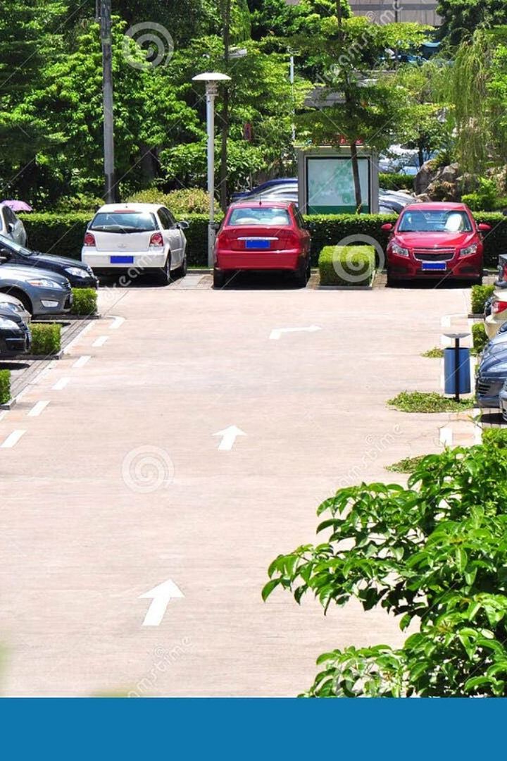
FPGA-Based Smart Car Parking System
EE-410L FPGA Based Design | Spring-2025
Group Members:
Abdul Ahad
Haider Bin Nadeem
Abdullah Ahmad
Department of Electrical Engineering

Slide 2
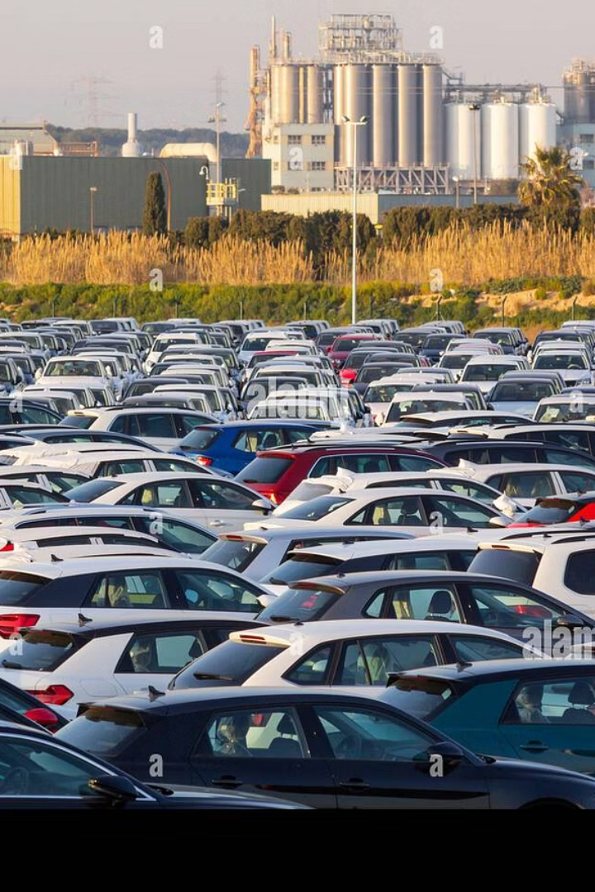




Importance of Smart Parking Systems
Urban Challenges
Time Wastage
Commercial Benefits
Vehicle density causes chaos and congestion.
Searching for parking increases frustration and delays.
Reduces wait times and optimizes space in malls.
Eco-Friendly
Lower fuel use reduces emissions and pollution.

Slide 3
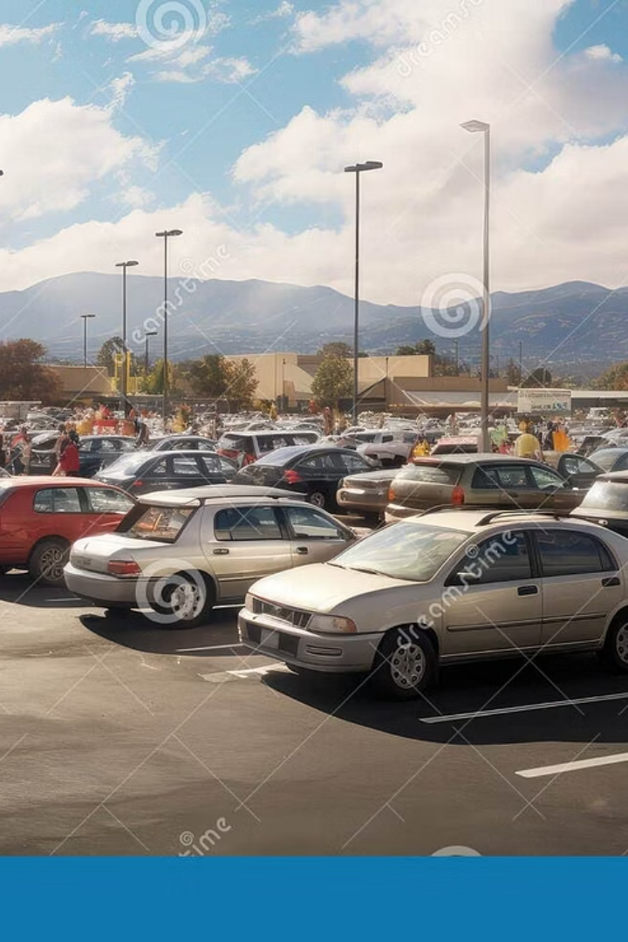
Problem Statement
Current Issues
Visibility Gap
Manual parking is inefficient and prone to errors.
No real-time display of available slots causes delay.
Technical Gaps
Lack of automated, scalable systems for smaller lots.

Slide 4
Project’s Output Objective
Automated Management
Ticket-Based Allocation
LCD Status Display
FPGA-based real-time parking slot control.
Unique codes map floors and slots precisely.
Shows Reserved, Reclaimed, Full, and Invalid states.
Reliable Inputs
Scalable Design
Debounced buttons ensure error-free entry/exit.
Parameterized Verilog allows flexible floors and slots.

Slide 5
Project Scope
FPGA Implementation
1
Using Spartan-3E with Verilog HDL for core design.
User Simplicity
2
Clear LCD messages and intuitive button interface.
Error Handling
3
Detects invalid tickets and manages full parking lots.

Slide 6
Parking System Top-Level Architecture
Inputs include physical buttons and a 4-bit ticket for exit validation.
Key modules: ActionStabilizer debounces inputs, Parking Controller manages slots, LCD Driver displays status.
Parameters: 3 floors, 4 slots per floor. Outputs: ticket code and current status.

Slide 7
Parking Controller Logic Overview
Dynamic Ticket Encoding
Slot Management
Exit Validation & Error Handling
Combines floor and slot bits into a 4-bit ticket code.
2D array tracks occupancy; scans for the first free slot on entry.
Validates tickets against lot map, signals invalid tickets or full lot.

Slide 8
Input Stabilization with ActionStabilizer
Problem
Solution
Implementation
Mechanical switch bounce causes false triggers.
150ms delay at 50MHz clock, producing a clean single-cycle logic pulse.
Reset on button press or timeout; pulse triggers parking logic.

Slide 9
LCD Driver State Machine
INIT State
1
Configures LCD to 4-bit mode using command sequence.
2
SET_POS State
Positions cursor at start of line 1 or 2.
SEND_H/L States
3
Splits 8-bit character into high and low nibbles for transmission.
4
EN_H/L States
Generates precise 240ns enable pulses for LCD enable signal.

Slide 10
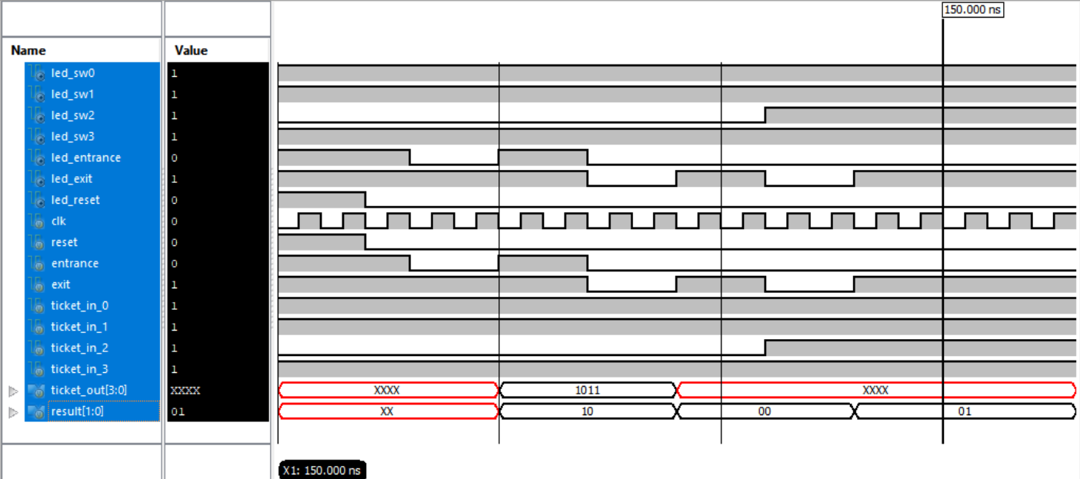
Simulation Waveform
Reclaimed: 00 Reserved: 10 Invalid Input: 01

Slide 11
System Workflow Overview
Reset State
Ticket Input (via Switches)
Entrance Process
The system clears all parking slots.
LCD displays a welcome message.
User selects a 4-bit pattern to represent a specific floor and slot.
System checks for available slot.
If available, reserves the slot.
LCD Displays: Ticket: [floor]-[slot]
Exit Process
System verifies ticket.
If valid, slot is freed and LCD shows: Reclaimed
If invalid, LCD shows: Invalid Ticket

Slide 12
Status Feedback via LCD
Reserved
1
LCD shows reserved status when user enters the input.
2
Parking Full
LCD shows parking full status when no more slot is available on any floor.
Reclaimed
3
LCD shows reclaimed status when user enters valid ticket.
4
Invalid Ticket
LCD shows invalid ticket status, when user inputs wrong ticket on entrance or exit.

Slide 13
Debugging Aids with LED’s
Switch LEDs: Each switch (SW0–SW3) directly maps to a corresponding LED for ticket preview.
Button Status LEDs:
Entrance LED blinks on entrance request.
Exit LED blinks on exit request.
Reset LED blinks during system initialization.
Purpose: Great for hardware-level debugging, even without LCD.

Slide 14
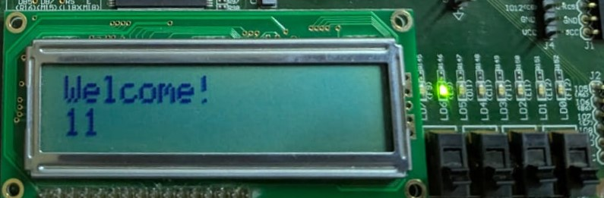
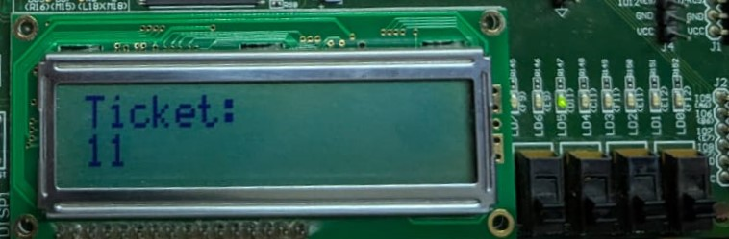
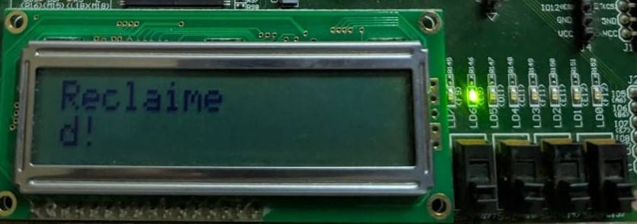
Hardware Implementation
Welcomed Message with available slots
Parking Slot assigned to the user
When user exit and assigned ticket was reclaimed

Slide 15
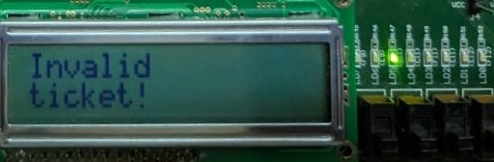
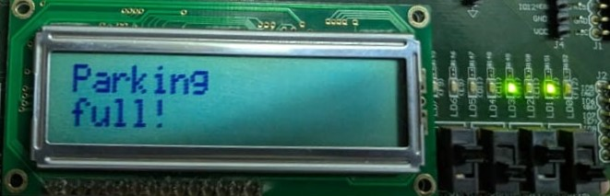
Hardware Implementation (continued)
If user entered invalid ticket number
It means no parking slot is available

Slide 16
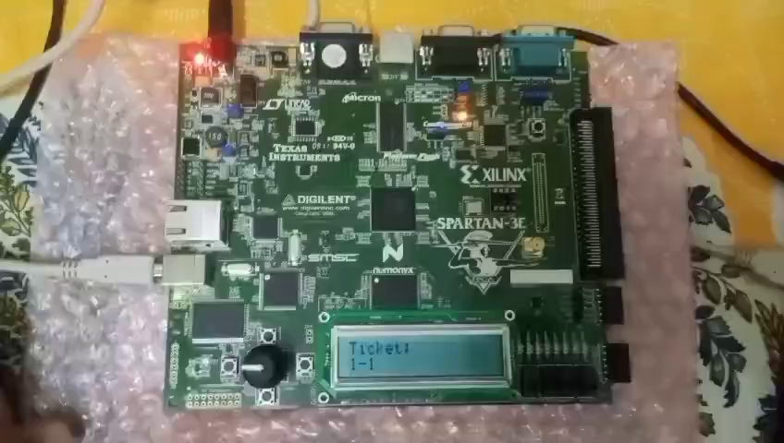

Slide 17
THANK YOU!

